Slide 1

AI Based Algorithmic Earnings forecasting
BY:
Samyak Rokade
Pranav Jadhav

Slide 2
What are Earnings? What determine Earnings of a company?
- A company's earnings are its after-tax net income, or profits, in a given quarter or fiscal year.
- Investors care about earnings because they ultimately drive stock prices. Strong earnings generally result in the stock price moving up (and vice versa).
- Earnings are ultimately a measure of the money a company makes and are often evaluated in terms of earnings per share (EPS), the most important indicator of a company's financial health. Earnings reports are released four times per year and are followed very closely by Wall Street.
Reference: https://www.investopedia.com/articles/basics/03/052303.asp

Slide 3
Is Historical Data enough?
There are many stock price prediction models in the market that analyze the trend of the historical data and predict the future stock price values.
The addition of sentiment adds an assuring variable that correlates with the future stock prices. As the news and emotion play an important role in the stock price of a company.
Reference: https://arxiv.org/pdf/2203.08143.pdf

Slide 4
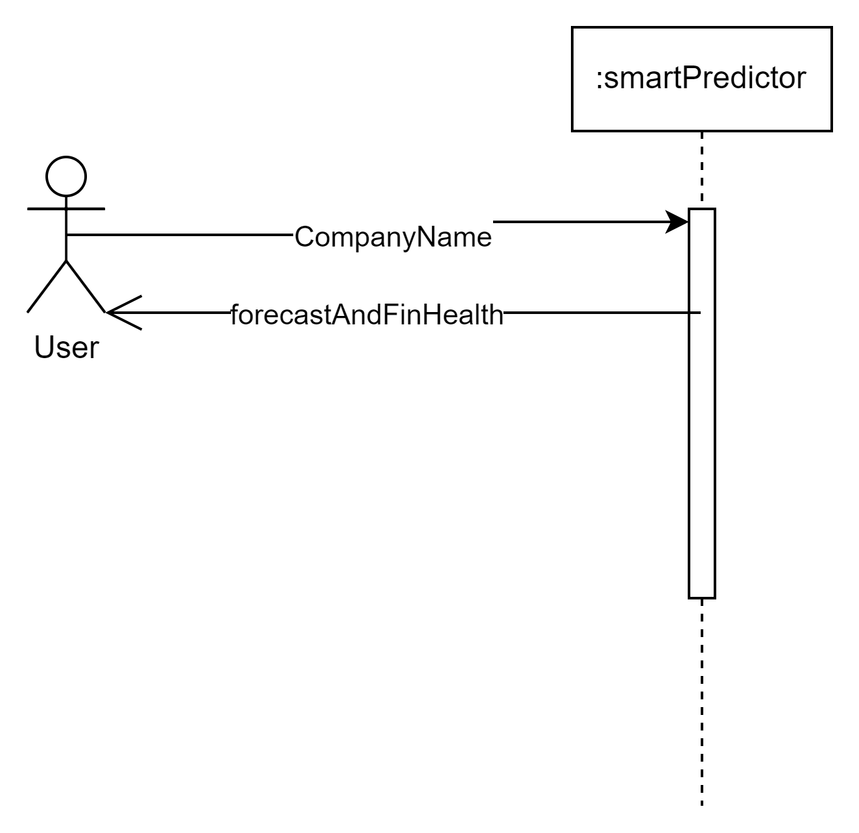
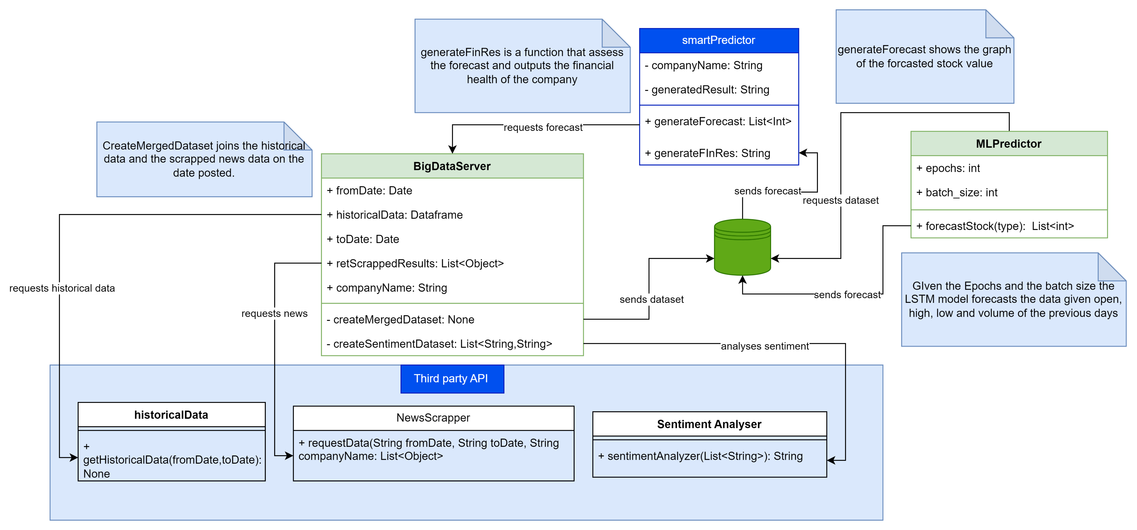
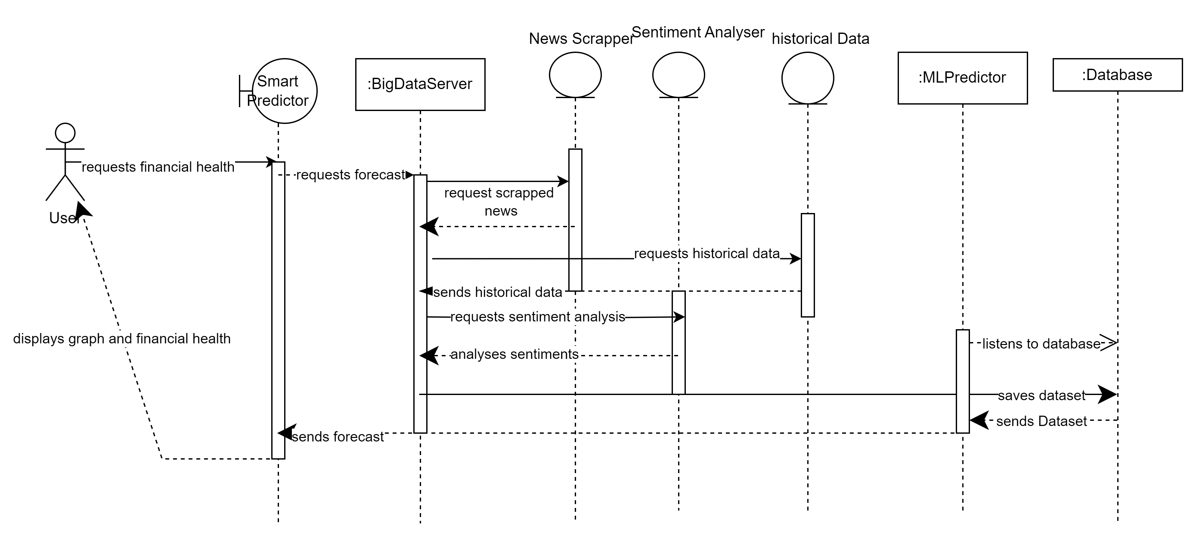
Design:
Domain model
System Class Diagram
System Sequence Diagram

Slide 5

System Class Diagram

Slide 6
System Sequence Diagram

Slide 7
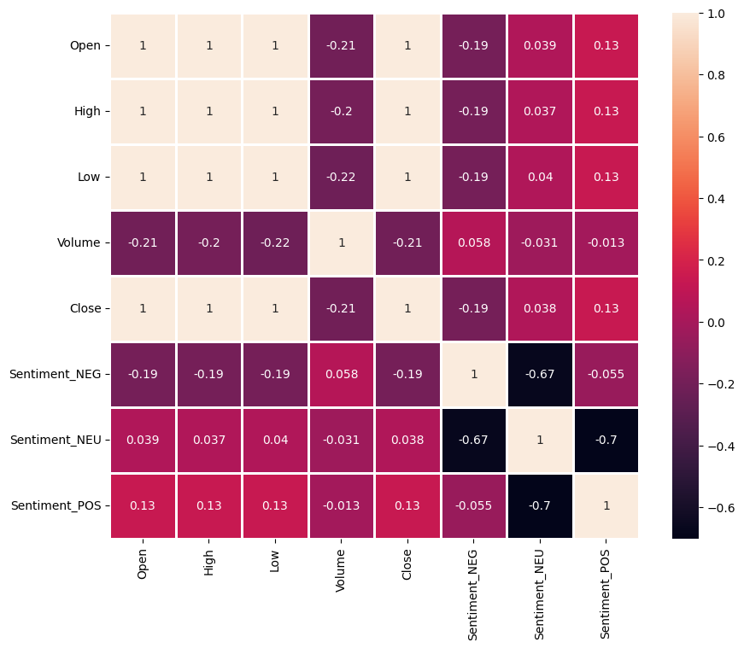
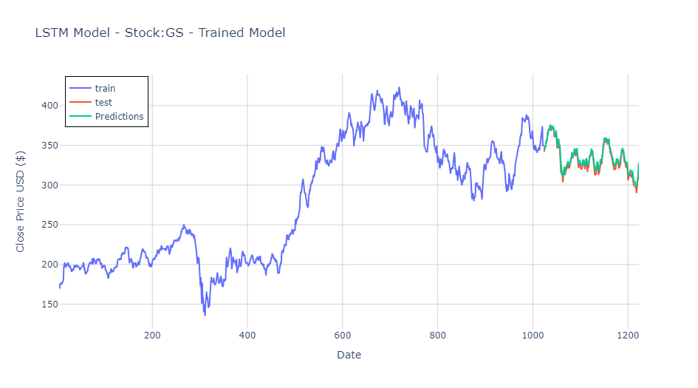
Results:

Slide 8
Objectives Achieved:
Created a dataset that has the historical data as well as the sentiment of the company at that particular
period.
Used open-source NLP technique to analyze sentiment of the company using current news of the
company.
Trained a LSTM model to predict the future stock prices.

